Slide 1





Prototyping image-guided therapy applications
David García Mato, Ph.D.
R&D engineer at Ebatinca S.L.
Las Palmas de Gran Canaria, Spain
Mónica García Sevilla, Ph.D.
Universidad de las Palmas de Gran Canaria
Las Palmas de Gran Canaria, Spain

Slide 2
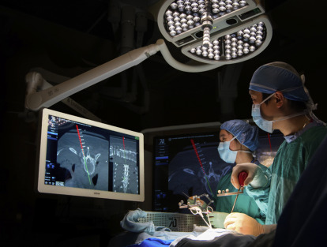
Outline
Introduction to image-guided therapy (IGT)
Tracking systems
Coordinate systems
IGT setup
Tool calibration
Image-to-patient registration
Examples of IGT applications in Slicer
Virtual and Augmented Reality applications

Slide 3
Introduction to IGT

Slide 4
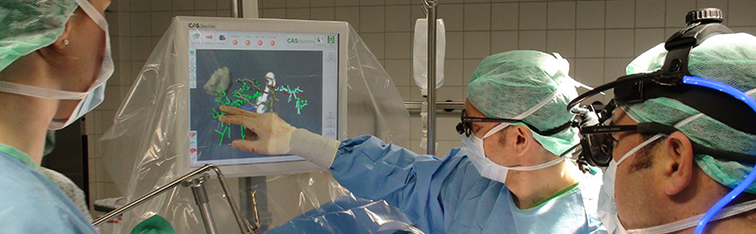
Image-Guided Therapy
Use medical imaging to plan, perform and evaluate surgical procedures
Objective → less invasive and more precise surgeries → shorter hospital stays
Common imaging modalities: CT and MRI. Others: US, angiography…
Use of special devices and software for tracking

Slide 5

Example
Tumor in the brain?
Intense headache. Painkillers not effective…
Medical Imaging
for Diagnosis

Slide 6
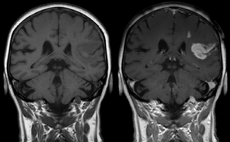
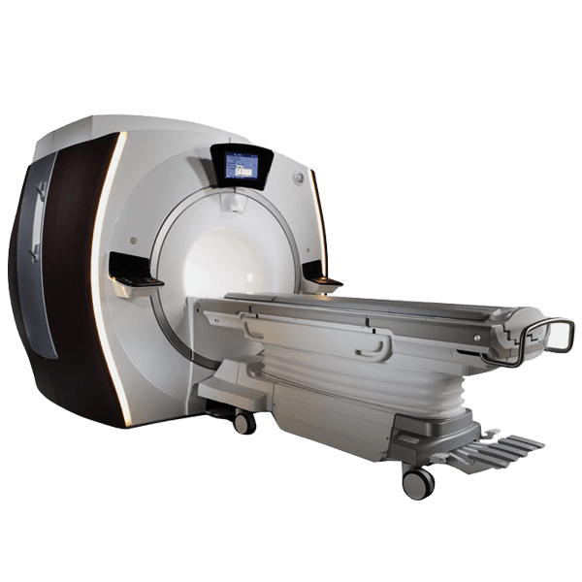

Example
Benign or malignant?

Slide 7
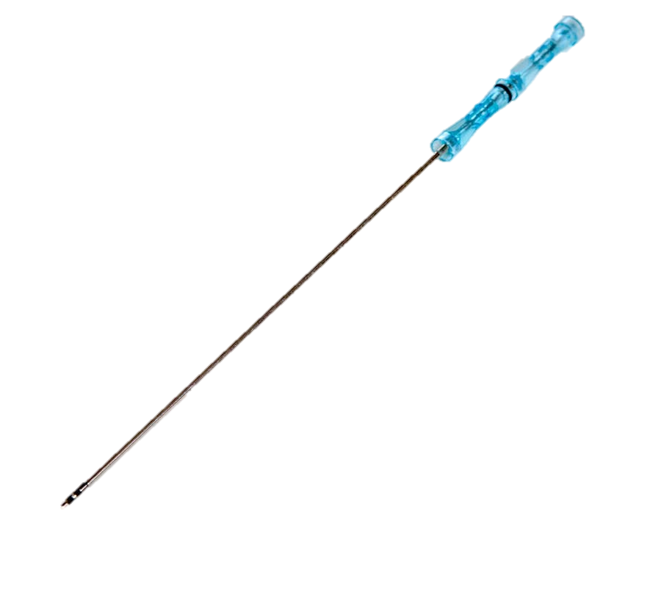

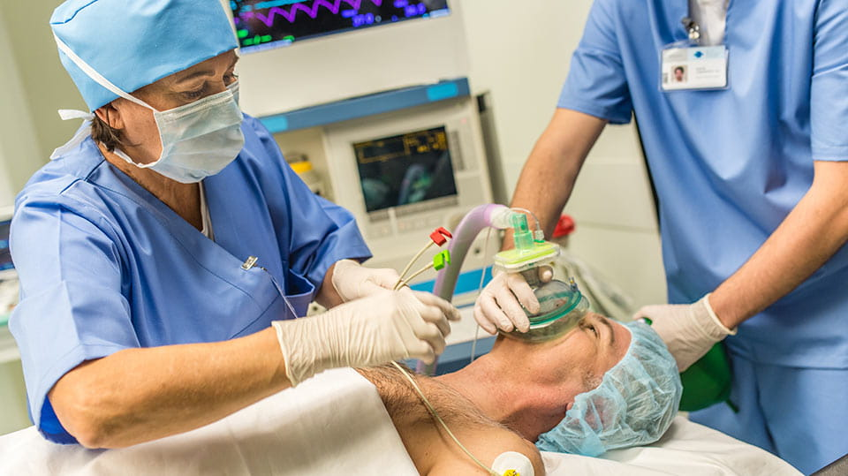
Example
Take patient to the OR → Perform the biopsy

Slide 8

Example
?
Where to insert the needle?
Which trajectory to follow?
When has the needle reached the tumor?

Slide 9

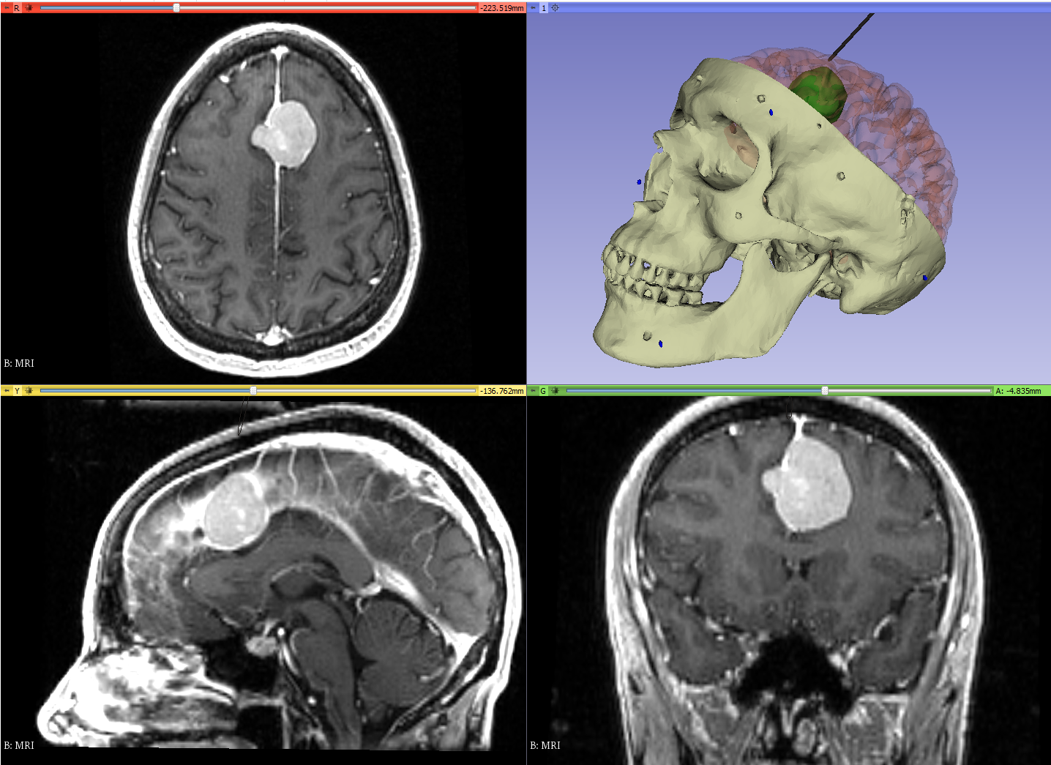



Example: IGT
Where to insert the needle?
Which trajectory to follow?
When has the needle reached the tumor?

Slide 10
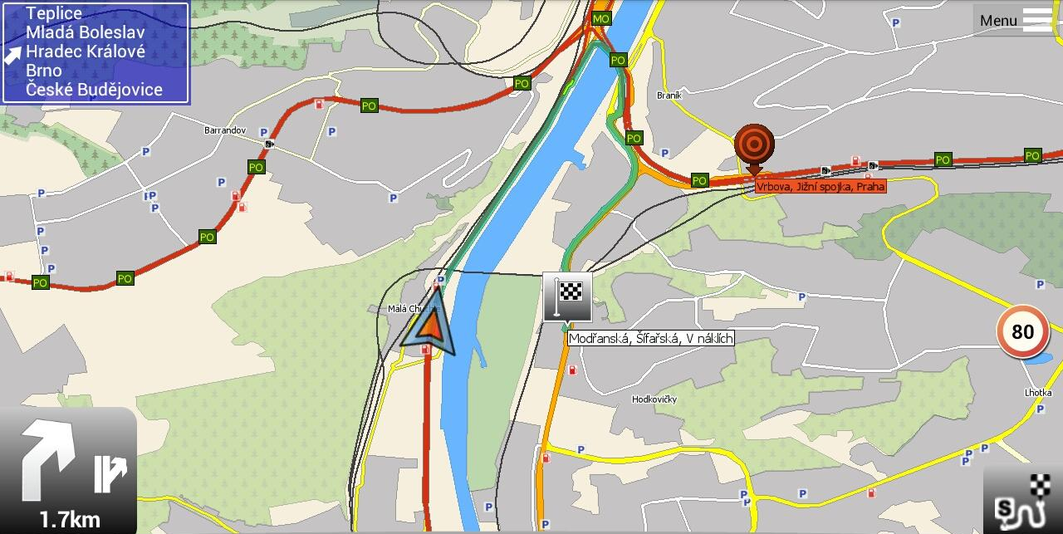
How to perform this guidance or navigation?
Notes:
And how does it work? Well, the idea is very similar to the navigation systems we are used to for the phone or the car

Slide 11
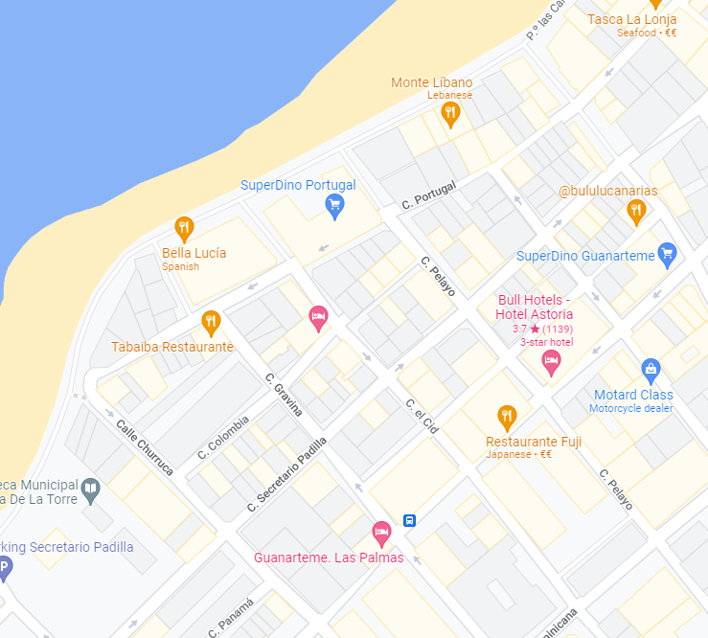
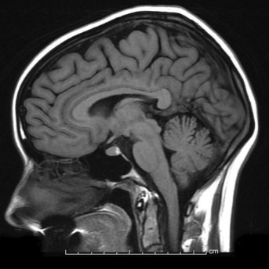

How to perform this guidance or navigation?
GPS NAVIGATION
SURGICAL NAVIGATION
Map + Position + Path
Medical Image + Tool Position + Path

Slide 12
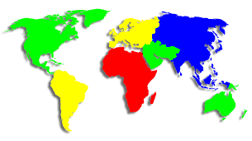

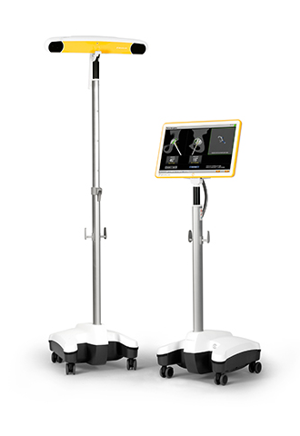

How to perform this guidance or navigation?
Map
Medical Images
We navigate by knowing our position in our map
How do we get our position?
Tracking system
Latitude
Longitude
3D coordinates space

Slide 13
Tracking Systems

Slide 14
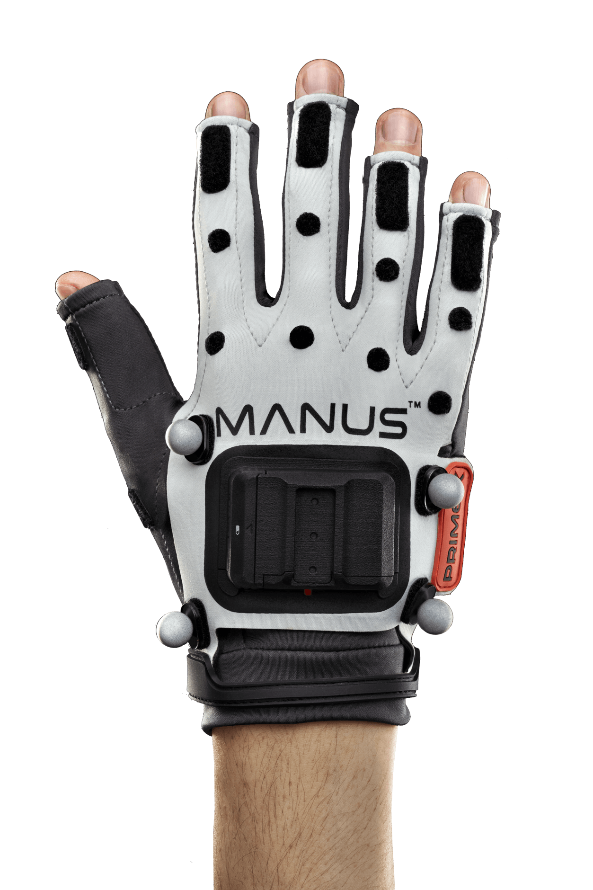

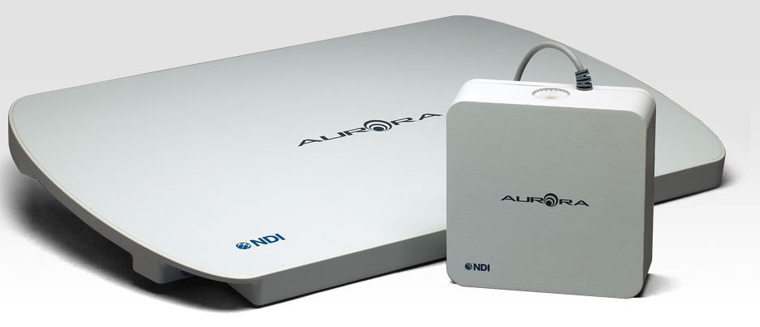
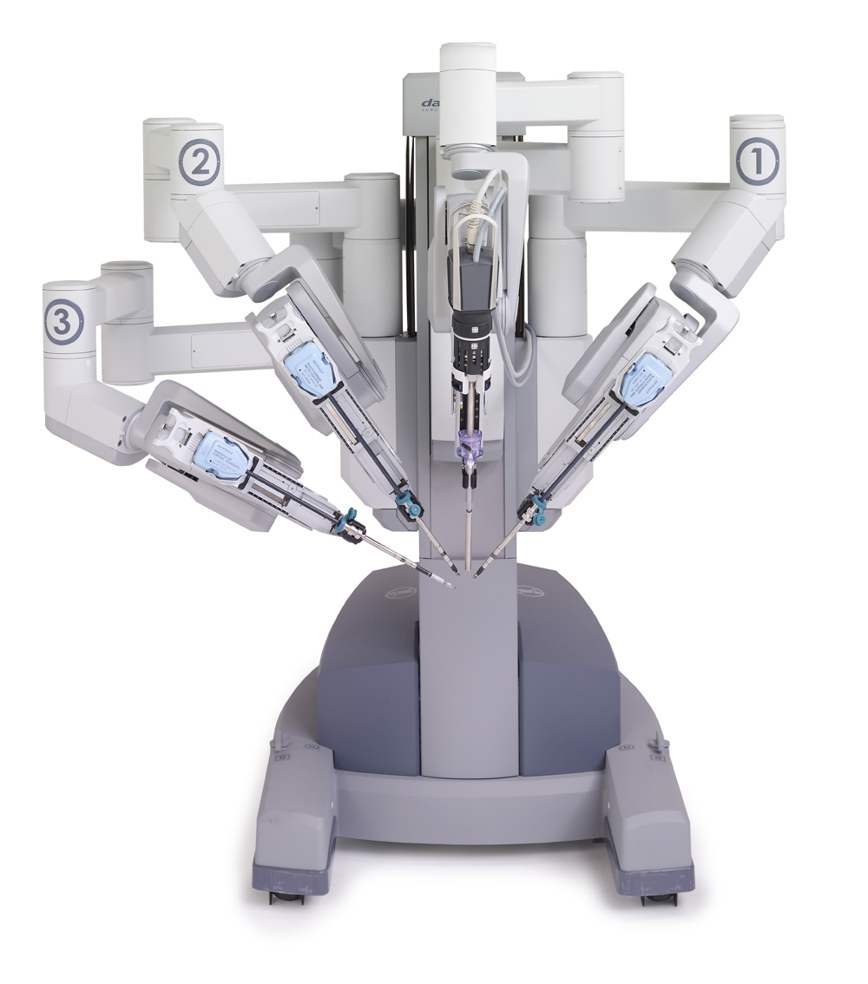
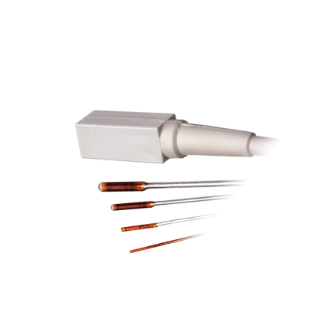
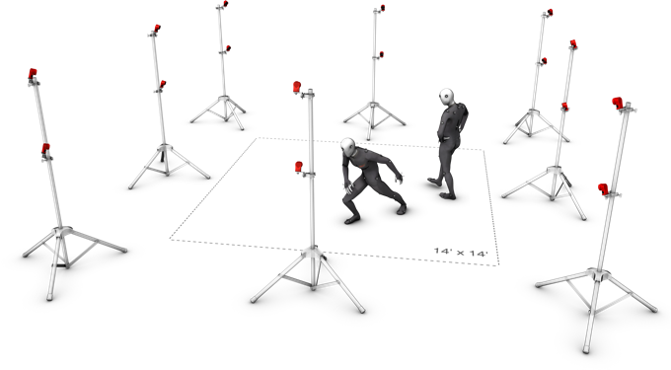
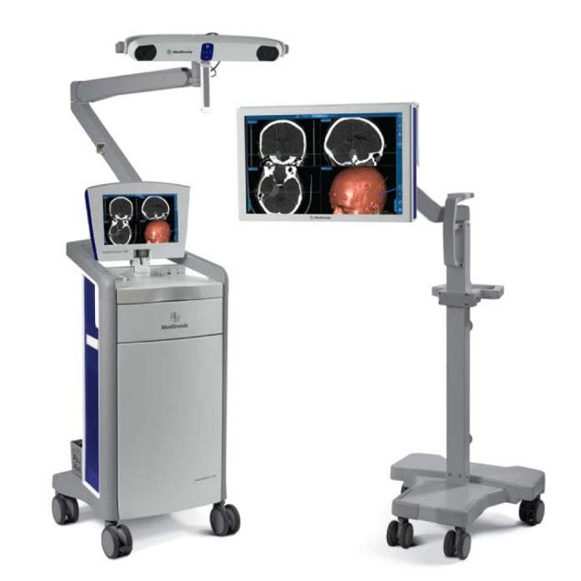
Tracking systems

Slide 15
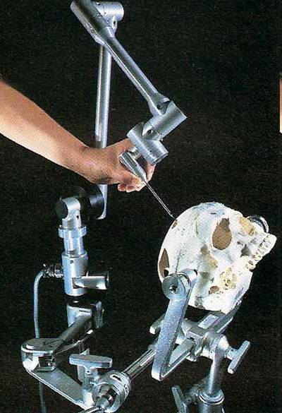
Mechanical tracking systems
Description:
Object to be tracked at the end of an articulated arm
Several sensors measure the angles between arm segments
Knowledge of segment sizes and angles provides the position and orientation of the tool
6 degrees of freedom
System is entirely self-referential:
rigid fixation of both the patient and the navigation arm is an important prerequisite

Slide 16
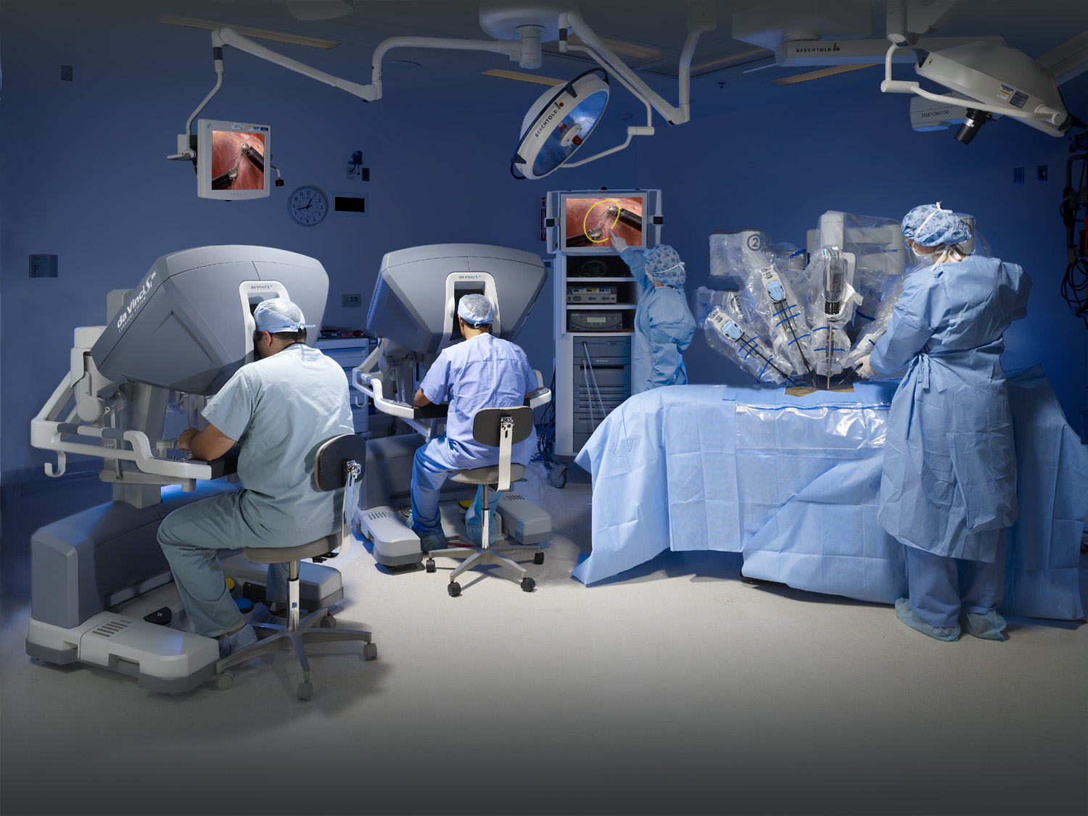
Mechanical tracking systems
Da Vinci Surgical System (Intuitive)

Slide 17
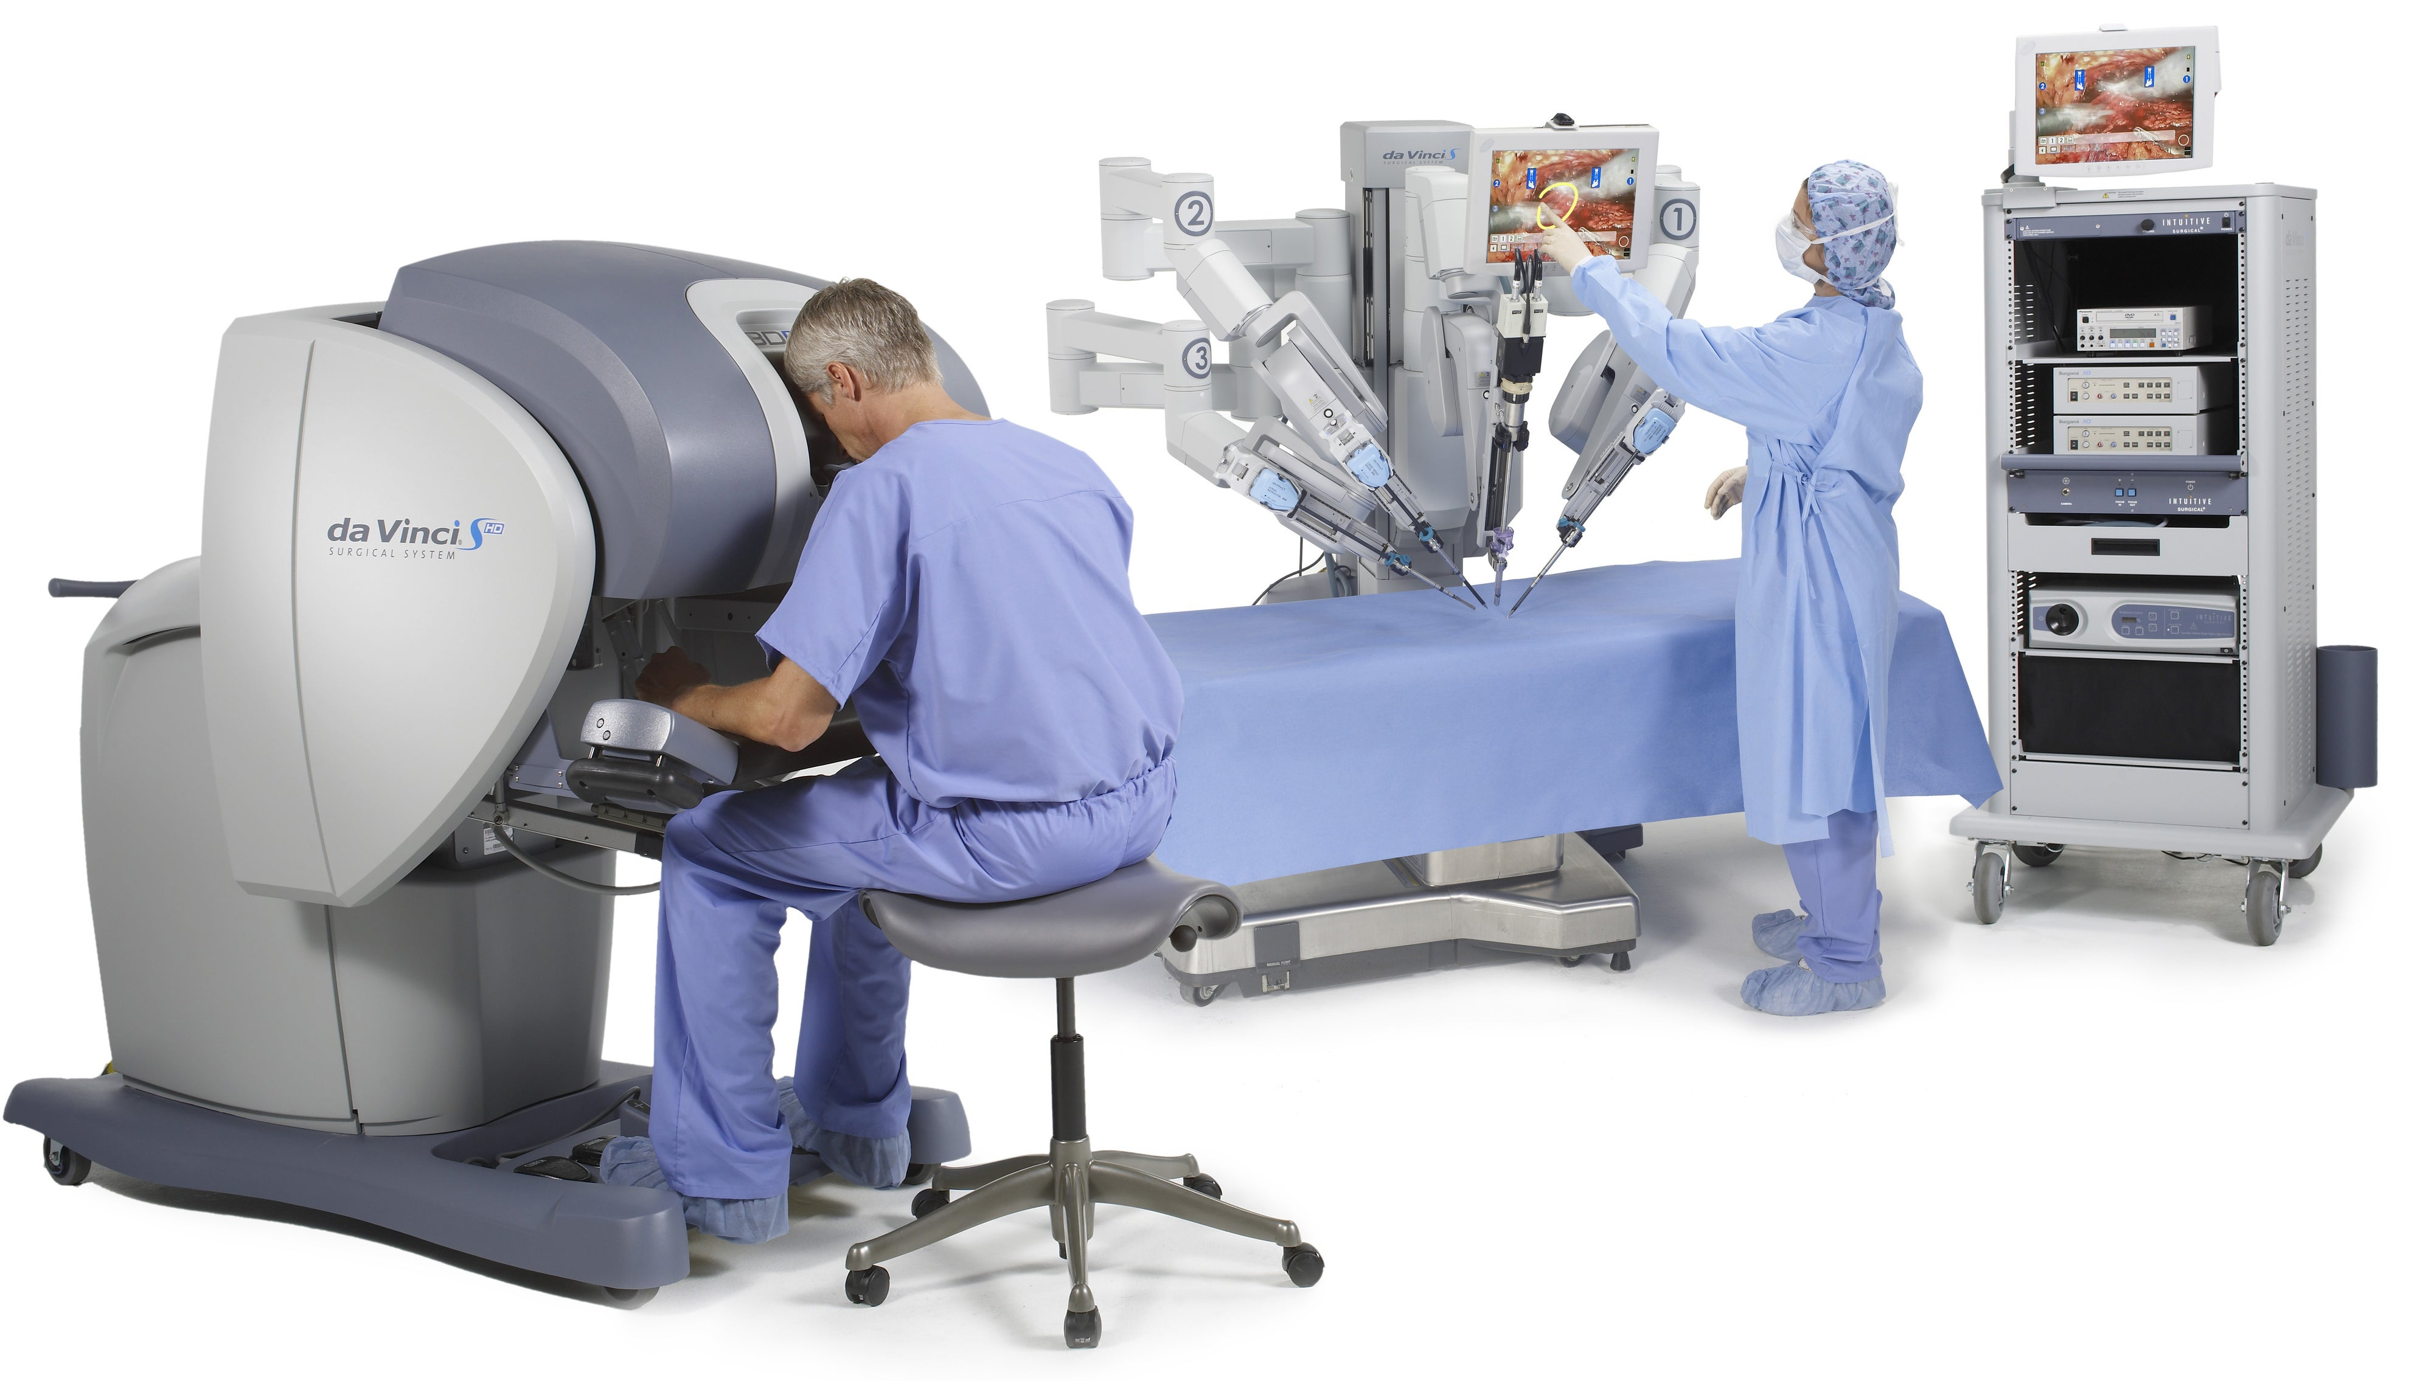
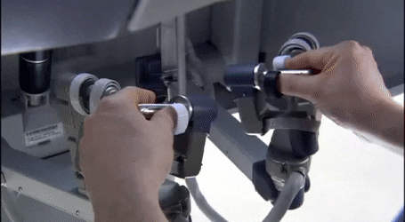
Mechanical tracking systems
Patient cart
Vision cart
Console

Slide 18
Mechanical tracking systems
ADVANTAGES
DISADVANTAGES
High precision
High update rate
Low susceptibility to failure
Impractical handling during some surgeries
Restricted range and mobility
Space requirements
Usually only one instrument can be tracked

Slide 19
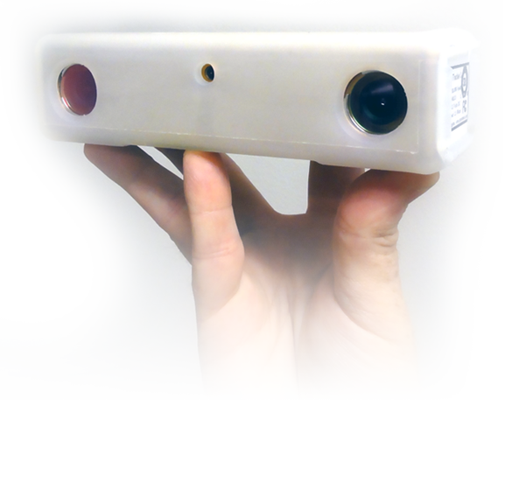
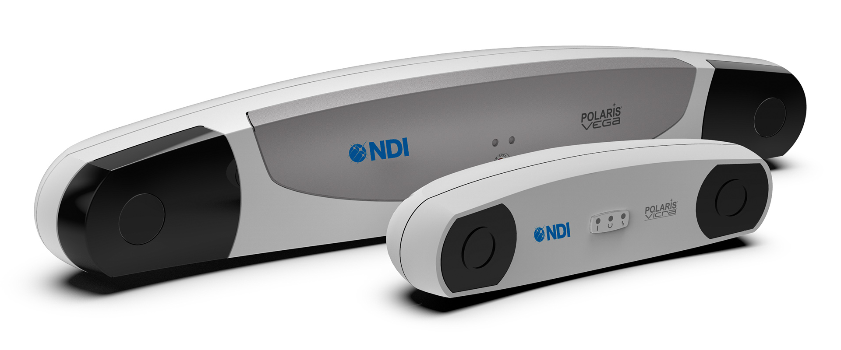
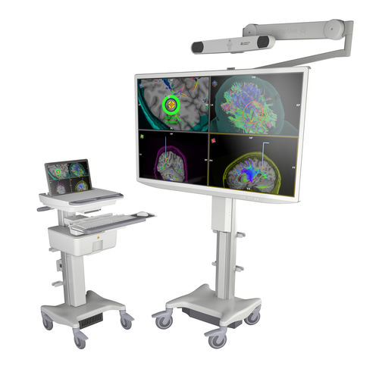
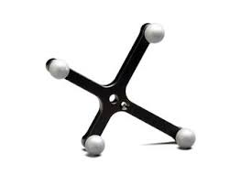
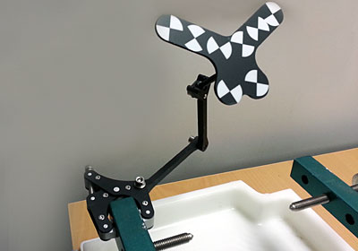
Optical tracking systems (OTS)
IR OTS
Visible light OTS

Slide 20
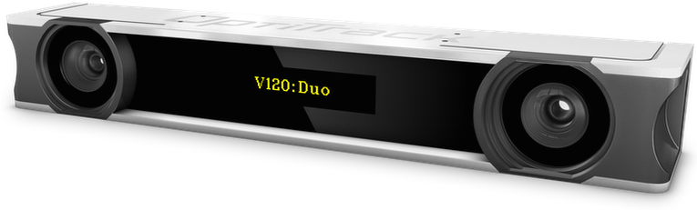
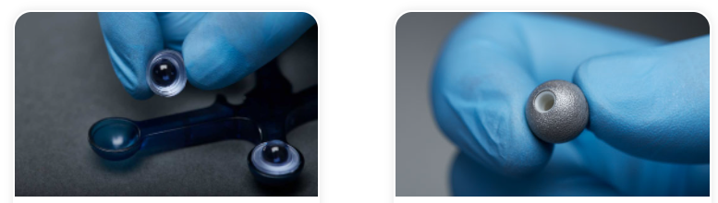
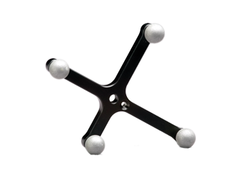
Optical tracking systems: IR
Y
Cam. 1
Cam. 2
X
Z
Active marker spheres
Y
X
Passive marker spheres
Z

Slide 21
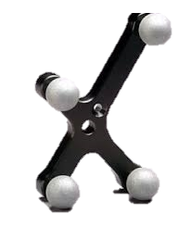
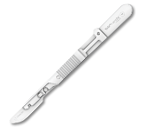

Optical tracking systems:IR
Y
Cam. 1
Cam. 2
X
Z
Active marker spheres
Y
X
Passive marker spheres
Z

Slide 22
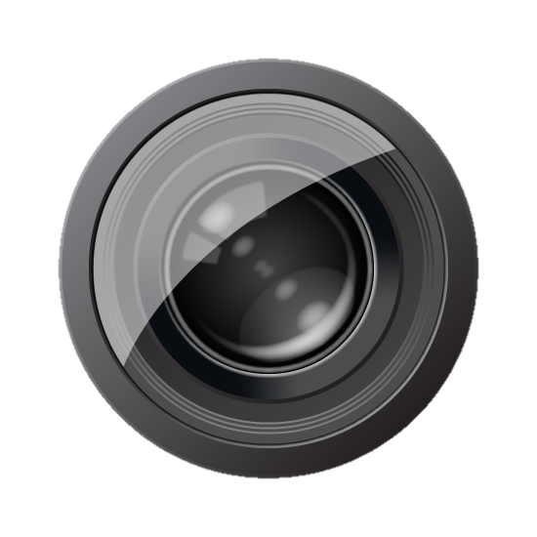
Optical tracking systems:IR
Y
X
Z
Known Spatial relationship between cameras
Point detected in every camera defines line in 3D
Camera A
Camera B
TRIANGULATION
Line intersection provides 3D position

Slide 23
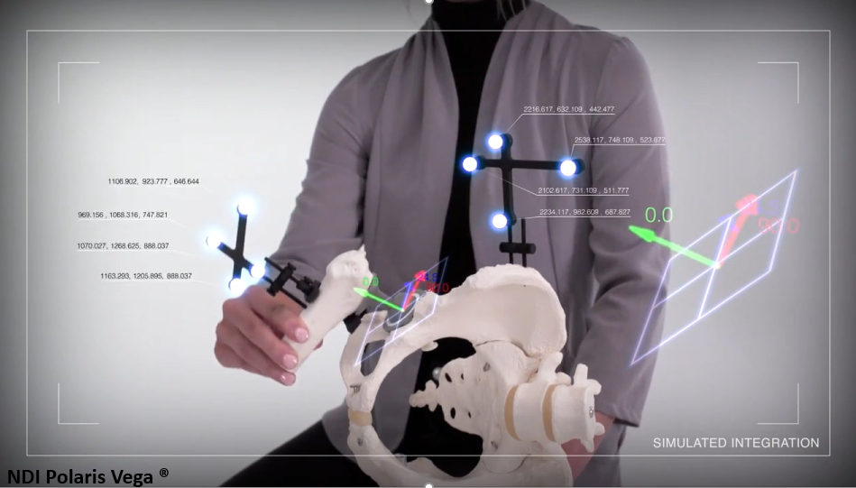
Optical tracking systems: IR
https://www.youtube.com/watch?v=D-jCxeWXt2o&ab_channel=MemoryTree

Slide 24
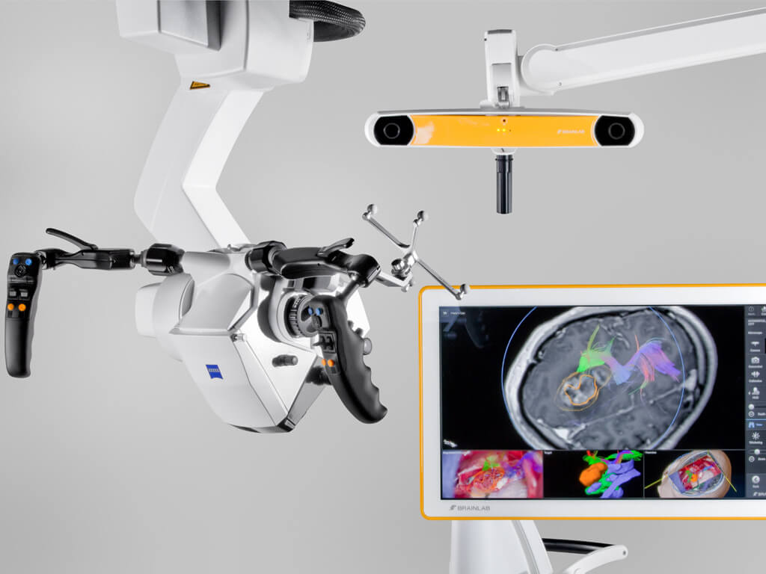
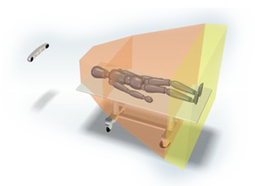
Optical tracking systems: IR

Slide 25
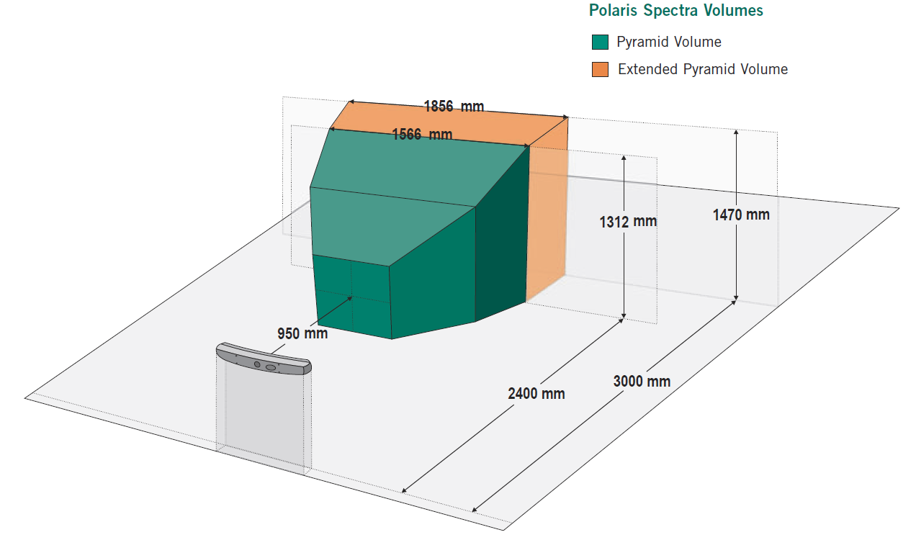
Optical tracking systems: IR

Slide 26
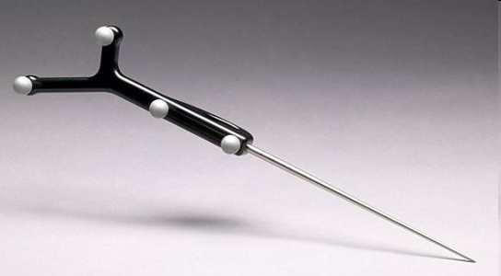
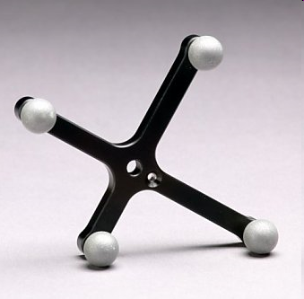
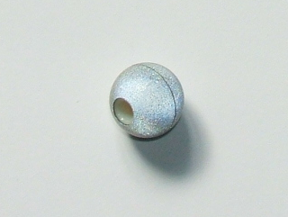
Optical tracking systems: IR
Cameras:
Tools with passive spherical markers:
Passive spherical markers:

Slide 27
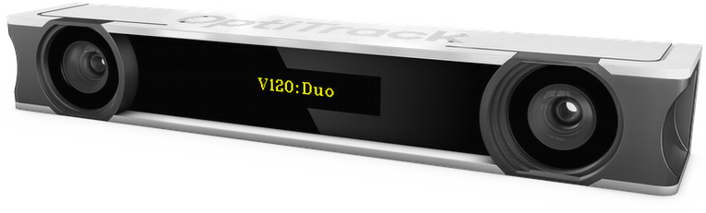
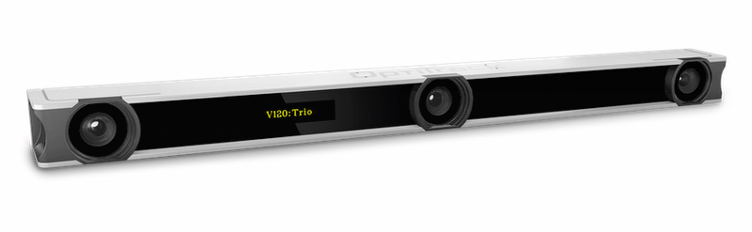
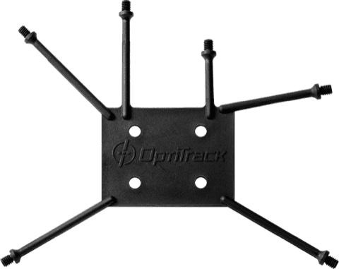
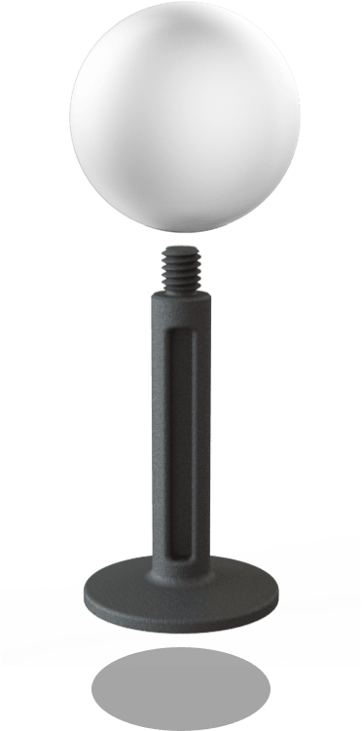
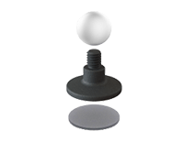
Optical tracking systems: IR
Optitrack:
Lower precision
Cheaper

Slide 28
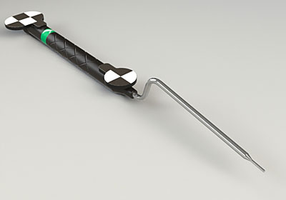
Optical tracking systems: Videometric
Description:
Standard cameras
Visible light
Geometrical patterns
Claron
MicronTracker

Slide 29
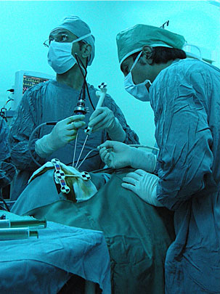
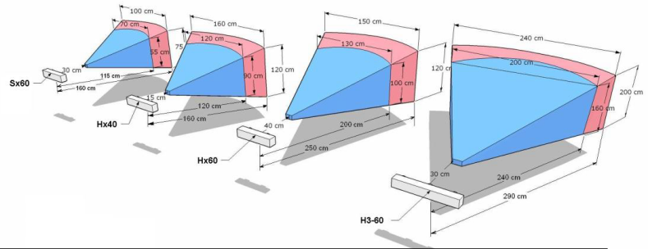
Optical tracking systems: Videometric
Claron MicronTracker
http://www.clarontech.com/microntracker-specifications.php
Specs:
Measurement rate 16-20 Hz
Accuracy 0.2-0.35 mm
Lag ~60 ms
Concurrent markers: 100
Illumination range: 50-100,000 lux

Slide 30
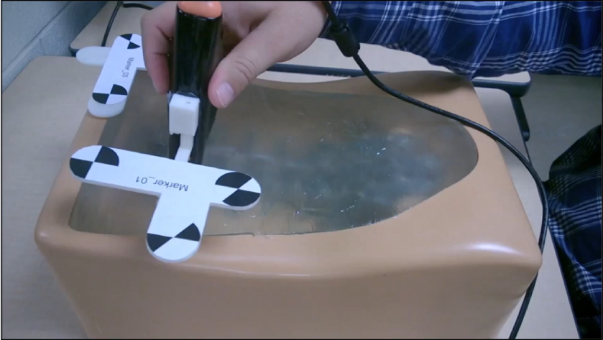
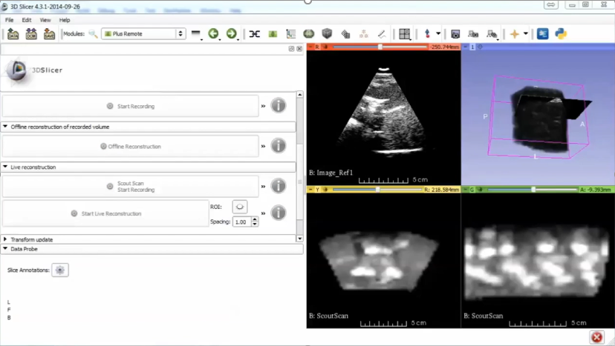
Optical tracking systems: Videometric
Claron MicronTracker
https://www.youtube.com/watch?v=lfZeXabDjMg&t=19s

Slide 31
Optical tracking systems
ADVANTAGES
DISADVANTAGES
Accuracy
Reliability
Working volume
Line-of-sight required
Tool design
Tool use in real environment

Slide 32


Optical vs Electromagnetic tracking systems
IR light
Electromagnetic field
Marker
Sensors

Slide 33

Electromagnetic tracking systems (EMTS)
for needles
NDI Aurora
NDI 3D Guidance

Slide 34



Electromagnetic tracking systems (EMTS)

Slide 35


Electromagnetic tracking systems (EMTS)
Serial port connection
SCU
(System Control Unit)
Power connection
Field generator
To PC
To power source
Tracked Tool (with sensor inside)

Slide 36



Electromagnetic tracking systems (EMTS)

Slide 37
Electromagnetic tracking systems (EMTS)
ADVANTAGES
DISADVANTAGES
Line-of-sight not required
Tool tip tracking (small sensors)
Ferromagnetic distortions
Working volume
Limited accuracy

Slide 38
Coordinate Systems

Slide 39

Coordinate system: definition
Left-handed or right-handed
Define origin:
Where is (0,0,0)?
Define directions
Which direction is X, Y, and Z?
Define units
How much is 1?
Y
X
Z

Slide 40

Coordinate system
Y
Trackers provide location and/or position information relative to a coordinate system.
(x,y,z) (r_{x},r_{y},r_{z})
Tool coordinate system
(0,0,0)
ToolToTrackerTransform
ROTATION
TRANSLATION
$$T=\left[\begin{matrix}\begin{matrix}R_{11} & R_{12} \\ R_{21} & R_{22}\end{matrix} & \begin{matrix}R_{13} & T_{x} \\ R_{23} & T_{y}\end{matrix} \\ \begin{matrix}R_{31} & R_{32} \\ 0 & 0\end{matrix} & \begin{matrix}R_{33} & T_{z} \\ 0 & 1\end{matrix}\end{matrix}\right]$$
X
(0,0,0)
Tracker coordinate system
Z

Slide 41




Transforms: examples
$$\begin{matrix}1 & 0 & 0 & 0 \\ 0 & 1 & 0 & 0 \\ 0 & 0 & 1 & 0 \\ 0 & 0 & 0 & 1\end{matrix}$$
"Identity transform"
Does nothing
$$\begin{matrix}1 & 0 & 0 & X \\ 0 & 1 & 0 & Y \\ 0 & 0 & 1 & Z \\ 0 & 0 & 0 & 1\end{matrix}$$
"Translation"
Pushes away
$$\begin{matrix}0.7 & 0.5 & 0.5 & 0 \\ 0 & 0.7 & −0.7 & 0 \\ −0.7 & 0.5 & 0.5 & 0 \\ 0 & 0 & 0 & 1\end{matrix}$$
"Rotation"
$$\begin{matrix}2 & 0 & 0 & 200 \\ 0 & 2 & 0 & 0 \\ 0 & 0 & 2 & 0 \\ 0 & 0 & 0 & 1\end{matrix}$$
"Scaling"
(and translation)

Slide 42
Coordinate system
[Tracker-To-Tool2] = [Tool2-To-Tracker] ⁻¹
Y
[Tool1-To-Tool2] = [Tool1-To-Tracker] * [Tracker-To-Tool2]
Tracker
Tool1-To-Tracker
X
Tool1-To-Tracker
Tool2-To-Tracker
Z
Transforms
describe every linear spatial relationship
internally represented by 4x4 matrices
concatenated by matrix multiplication
Tracker-To-Tool2
Tracker-To-Tool2
Y
Y
Tool 1
X
Tool 2
X
Z
Z
Tool1-To-Tool2

Slide 43
Where do transforms come from?
Tracking system
Registration/Calibration
Transform is updated to provide the “real-time” position of a given object
Transform stays constant until next registration/calibration

Slide 44
Example of IGT setup

Slide 45

Navigate needle insertion using optical tracker
https://www.youtube.com/watch?v=d_vHpBRZJco

Slide 46



Setup
Tracker
Needle-To-Tracker
Tracker-To-Reference
Needle
NeedleTip-To-Needle
Reference
Needle Tip
Reference-To-Phantom
Phantom

Slide 47

Tool tracking
Needle-To-Tracker
Reference-To-Tracker

Slide 48


Tool tracking
Tracking System
PLUS Toolkit
3D Slicer
Tracker SDK
Synchronization
SlicerIGT
Visualization
Imaging SDK
Calibration
Registration
Segmentation
… SDK
OpenIGTLink
OpenIGTLink
Quantification

Slide 49

Setup
Tracker
Needle-To-Tracker
Tracker-To-Reference
Needle
NeedleTip-To-Needle
Reference
Needle Tip
Reference-To-Phantom
Phantom

Slide 50
Setup
Tracker
Needle-To-Tracker
Tracker-To-Reference
Needle
NeedleTip-To-Needle
Reference
Needle Tip
Reference-To-Phantom
Phantom

Slide 51


Needle Calibration
Needle
?
?
?
Needle Tip
?

Slide 52

Needle Calibration
Y
Needle
X
Z
NeedleTip-To-Needle
$$T=\left[\begin{matrix}\begin{matrix}R_{11} & R_{12} \\ R_{21} & R_{22}\end{matrix} & \begin{matrix}R_{13} & T_{x} \\ R_{23} & T_{y}\end{matrix} \\ \begin{matrix}R_{31} & R_{32} \\ 0 & 0\end{matrix} & \begin{matrix}R_{33} & T_{z} \\ 0 & 1\end{matrix}\end{matrix}\right]$$
Y
Needle Tip
X
Z

Slide 53


Needle Calibration
Pivoting
Needle Tip

Slide 54




Tool calibration: how to compute it?
Pivot calibration can be easily done using the “Pivot Calibration” module within SlicerIGT extension.
ROTATION
TRANSLATION

Slide 55
Setup
Tracker
Needle-To-Tracker
Tracker-To-Reference
Needle
NeedleTip-To-Needle
Reference
Needle Tip
Reference-To-Phantom
Phantom

Slide 56
Setup
Tracker
Needle-To-Tracker
Tracker-To-Reference
Needle
NeedleTip-To-Needle
Reference
Needle Tip
Reference-To-Phantom
Phantom

Slide 57
Phantom Registration
Y
Reference
Z
X
Y
Z
X
Reference-To-Phantom
Phantom

Slide 58

Phantom Registration
Phantom landmarks
(recorded directly over the 3D model/volume of the phantom)

Slide 59


Phantom Registration
Reference landmarks
(recorded using tracked tool relative to “Reference” coordinate system)
5
4
3
1
2

Slide 60
Phantom Registration: computation
Phantom Fiducials
(relative to phantom coordinate system)
Reference Fiducials
(relative to reference coordinate system)
5
5
4
4
3
3
1
1
2
2

Slide 61
Phantom Registration: computation
Phantom Fiducials
(relative to phantom coordinate system)
Reference Fiducials
(relative to reference coordinate system)
Minimize distance between homologous points
5
5
4
4
3
3
1
1
2
2
Reference-To-Phantom

Slide 62



Phantom Registration: how to compute it?
Landmark registration can be easily done using the “Fiducial registration wizard” module within SlicerIGT extension.
ROTATION
TRANSLATION

Slide 63
Setup
Tracker
Needle-To-Tracker
Tracker-To-Reference
Needle
NeedleTip-To-Needle
Reference
Needle Tip
Reference-To-Phantom
Phantom

Slide 64

Setup
Tracker
Needle-To-Tracker
Tracker-To-Reference
Needle
NeedleTip-To-Needle
Reference
Needle Tip
Reference-To-Phantom
Phantom

Slide 65
Navigate needle insertion using optical tracker
https://www.youtube.com/watch?v=d_vHpBRZJco

Slide 66
Examples of IGT applications
Computer-assisted breast tumor excision (LumpNav): https://www.youtube.com/watch?v=gSz8IHmogMo
Computer-assisted orbital floor reconstruction: https://www.youtube.com/watch?v=OzqBqOZsc7M
Computer-assisted dental implant placement: https://www.youtube.com/watch?v=ytq9V2paDzc
Computer-assisted craniofacial surgery (CranioNav): https://doi.org/10.1038/s41598-019-54148-4
Training needle insertion skills (PerkTutor): https://www.youtube.com/watch?v=KfdQ3WwTQHw&t=27s
Forceps-assisted delivery training: https://www.youtube.com/watch?v=EEasWbH1jZI
SlicerVR: https://www.youtube.com/watch?v=F_UBoE4FaoY
Collaborative virtual reality: https://www.youtube.com/watch?v=Sw3JyKfvW6Q

Slide 67
Prototyping image-guided therapy applications
David García Mato, Ph.D.
R&D engineer at Ebatinca S.L.
Las Palmas de Gran Canaria, Spain
Mónica García Sevilla, Ph.D.
Universidad de las Palmas de Gran Canaria
Las Palmas de Gran Canaria, Spain

